Slide 1




Software Engineering Fundamentals
Software Development Phases, Practices and Methodologies
High-Quality Code
SoftUni Team
Technical Trainers
http://softuni.bg
Software University

Slide 2

Table of Contents
Software Engineering Overview
Requirements
Design
Construction
Testing
Project Management
Development Methodologies Overview
The Waterfall Development Process
Heavyweight Methodologies
Agile Methodologies and Scrum

Slide 3

Software Engineering
Requirements, Design, Construction, Testing

Slide 4


What is Software Engineering?
Software engineering is the application of a systematic, disciplined and quantifiable approach to the development, operation, and maintenance of software.
Definition by IEEE

Slide 5


Software Engineering
Software engineering is:
An engineering discipline that provides knowledge, processes, tools, and approaches for:
Defining software requirements
Performing software design
Software construction
Software testing
Software maintenance tasks
Software project management

Slide 6
Software Development Activities
Software development always includes the following activities (to some extent):
Requirements analysis
Design
Construction
Testing
These activities do not follow strictly one after another (depends on the methodology)!
Often overlap and interact
Software Project Management

Slide 7

Software Requirements
Functional & Non-Functional Requirements, Requirements Specification, User Story Cards

Slide 8

Software Requirements
Software requirements describe the functionality of the software
Answer the question "what?", not "how?"
Define constraints on the system
Two kinds of requirements
Functional requirements
Non-functional requirements

Slide 9
Requirements Analysis
Requirements analysis starts from an idea about the system
Customers usually don't know what they need!
Requirements come roughly → adjusted during the development
Requirements change constantly!
The outcome is some requirements documentation
Software Requirements Specification (SRS) / User Stories / UI prototype / informal system description / etc.
Prototyping is often used, especially for the user interface (UI)

Slide 10

Software Requirements Specification (SRS)
The Software Requirements Specification (SRS) is a formal requirements document
SRS describes in details:
Functional requirements
Business processes
Actors and use-cases
Non-functional requirements
E.g. performance, scalability, hardware, integrations, constraints, security, etc.

Slide 11
Agile Requirements and User Stories
Formal specifications are too heavy
Do not work well in dynamic projects that change their requirements every day
Agile development needs agile requirements
Pieces of functionality, implemented in many small iterations
How to split the requirements?
Use simple, informal requirements description
User story: a small feature that brings some value to the end-user

Slide 12
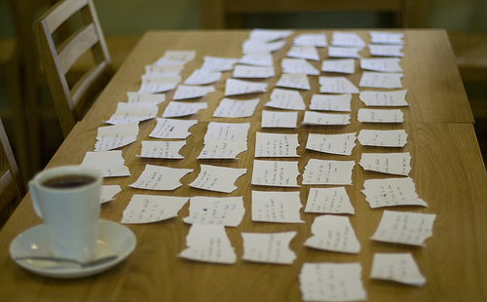
What is User Story?
User story
User needs to accomplish something
Written informally (in words / images / sketches)
Looks like a use-case but is different (less formal)
User stories have
Actor (who?)
Goal (what?, why?)
Other info
Owner, estimate, …

Slide 13
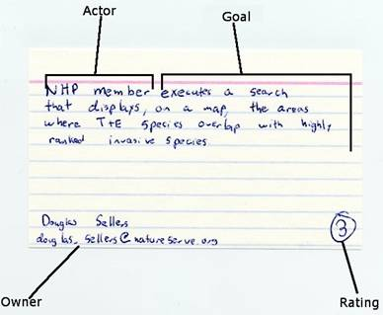
User Story – Example

Slide 14
Software Requirements
It is always hard to describe and document the requirements in comprehensive way
Good requirements save time and money
Requirements always change during the project!
Good requirements reduces the changes
UI prototypes significantly reduce changes
Agile methodologies are flexible to changes
Incremental development in small iterations

Slide 15

Software Requirements Specifications (SRS), User Stories and UI Prototypes
Live Demo

Slide 16
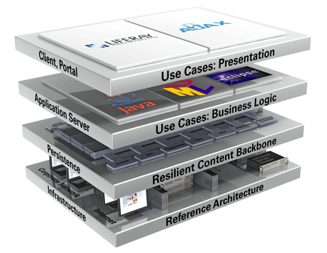
Software Architecture and Software Design

Slide 17

Software Architecture and Software Design
Software design is a technical description (blueprints) about how the system will implement the requirements
The system architecture describes:
How the system will be decomposed into subsystems (modules)
Responsibilities of each module
Interaction between the modules
Platforms and technologies

Slide 18
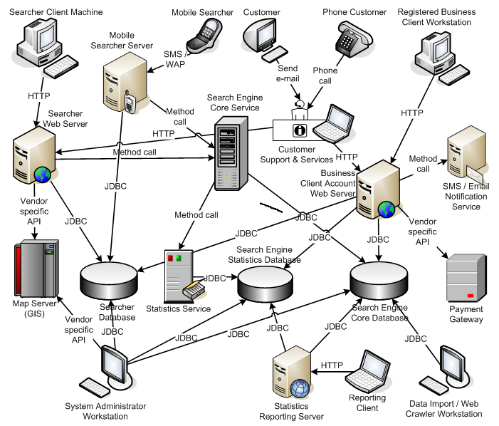
System Architecture Diagram – Example

Slide 19
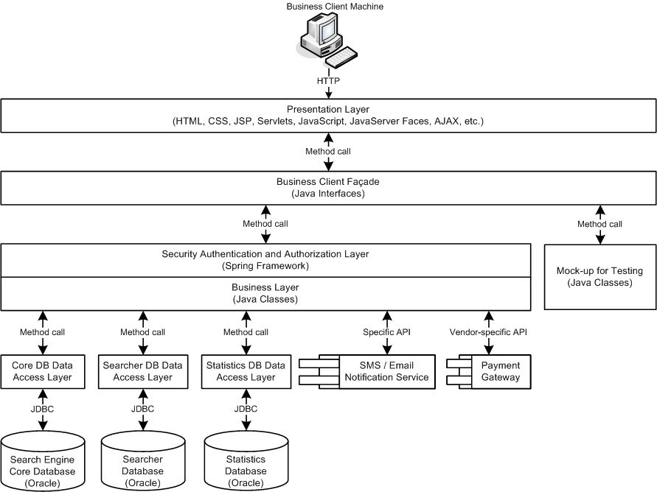
Software Architecture Diagram – Example

Slide 20
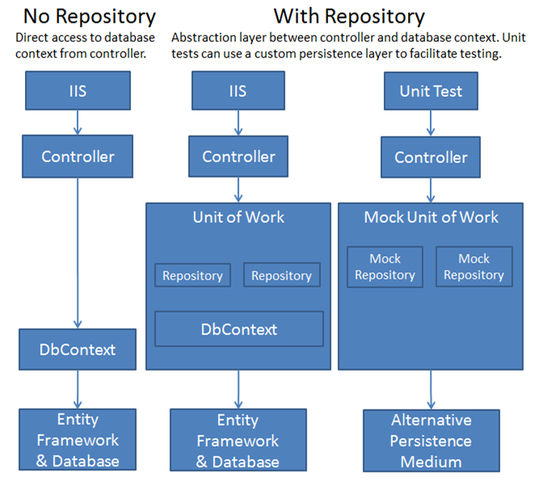
Architectural Diagram – Another Example

Slide 21
Software Design
Detailed Design
Describes the internal module structure
Subcomponents, interfaces, process design, data design
Object-Oriented Design
Describes the classes, their responsibilities, relationships, dependencies, and interactions (usually in UML)
Internal Class Design
Methods, responsibilities, algorithms and interactions

Slide 22

Software Design Document (SDD)
The Software Design Document (SDD)
Formal description of the architecture and design of the system
SDD contains:
Architectural design
Modules and their interaction (diagram)
For each module
Process design (diagrams)
Data design (E/R diagram)
Interfaces design (class diagram)

Slide 23

Software Design Document
Live Demo

Slide 24

Software Construction
Implementation, Unit Testing, Debugging, Integration

Slide 25

Software Construction
During the software construction phase developers build the software
Sometimes called implementation phase
Software construction includes:
Internal method design
Writing the source code
Writing the unit tests (optionally)
Testing and debugging
Integration

Slide 26

Writing the Code
Coding is the process of writing the programming code (the source code)
The code strictly follows the design
Developers perform internal method design as part of coding
The source code is the output of the software construction process
Written by developers
Can include unit tests

Slide 27


Testing the Code
Testing checks whether the developed software conforms to the requirements
Aims to identify defects (bugs)
Developers test the code after writing it
At least run it to see the results
Unit testing works better
Units tests are repeated many times
System testing is done by the QA engineers
Unit testing is done by developers

Slide 28
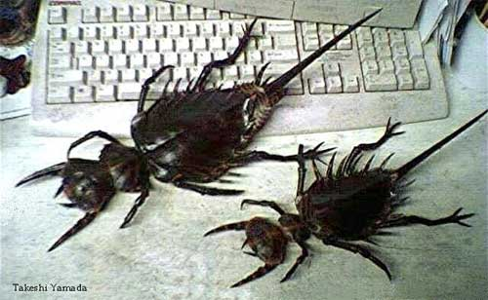
Debugging
Debugging aims to find the source of already identified defect and to fix it
Performed by developers
Steps in debugging:
Find the defect in the code
Identify the source of the problem
Identify the exact place in the code causing it
Fix the defect
Test to check if the fix is working correctly

Slide 29

Software Integration
Integration is putting all pieces together
Compile, run and deploy the modules as a single system
Test to identify defects (integration testing)
Integration strategies
Big bang (all or almost all modules are tested at the same time)
Top-down (integration tests of the higher-level layers first)
Bottom-up
Continuous integration (CI)

Slide 30
Coding != Software Engineering
Inexperienced developers consider coding the core of development
In most projects coding is only 20% of the project activities!
The important decisions are taken during the requirements analysis and design
Documentation, testing, integration, maintenance, etc. are often disparaged
Software engineering is not just coding!
Programmer != software engineer

Slide 31
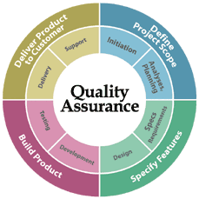
Software Quality Assurance (QA)

Slide 32

Software Quality Assurance (QA)
What is software quality assurance (QA)?
Ensures quality of the software and the development process
Performed by the Quality Assurance Engineers (QA engineers)
Two approaches:
Testing (manual and automated)
Formal reviews and inspections
Cannot certify absence of defects!
Can only decrease their rates

Slide 33
Software Testing
Testing checks whether the developed software conforms to the requirements
Testing aims to find defects (bugs)
Black-box and white-box tests
Unit tests, integration tests, system tests, acceptance tests
Stress tests and load tests
Regression tests
Tester engineers can use automated test tools to record and execute tests

Slide 34


Software Testing Process
Test planning
Establish test strategy and test plan
During requirements and design phases
Test development
Test procedures, test scenarios, test cases, test scripts
Test execution
Test reporting
Retesting the defects

Slide 35
Test Plan and Test Cases
The test plan is a formal document that describes how tests will be performed
List of test activities to be performed to ensure meeting the requirements
Features to be tested, testing approach, schedule, acceptance criteria
Test scenarios and test cases
Test scenarios – stories to be tested
Test cases – tests of single function

Slide 36


Test Plans and Test Cases
Live Demo

Slide 37
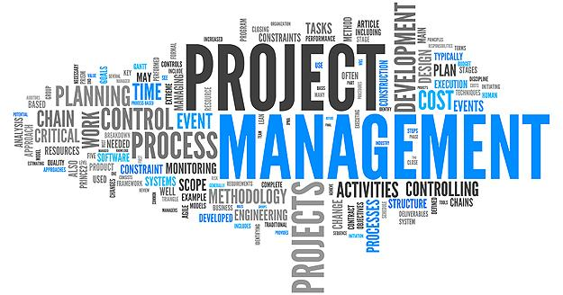
Software Project Management

Slide 38
What is Project Management?
Project management is the discipline of
Organizing and managing work and resources in order to successfully complete a project
Successfully means within defined scope, quality, time and cost constraints
Project constraints:
Scope
Quality
Cost
Time

Slide 39
What is Software Project Management?
Software project management
Management discipline about planning, monitoring and controlling software projects
Project planning
Identify the scope, estimate the work involved, and create a project schedule
Project monitoring and control
Keep the team up to date on the project's progress and handle problems

Slide 40
What is Project Plan?
The project plan is a document that describes how the work on the project will be organized
Contains tasks, resources, schedule, milestones, etc.
Tasks have start, end, assigned resources (team members), % complete, dependencies, nested tasks, cost, etc.
Project management tools simplify creating and monitoring project plans

Slide 41
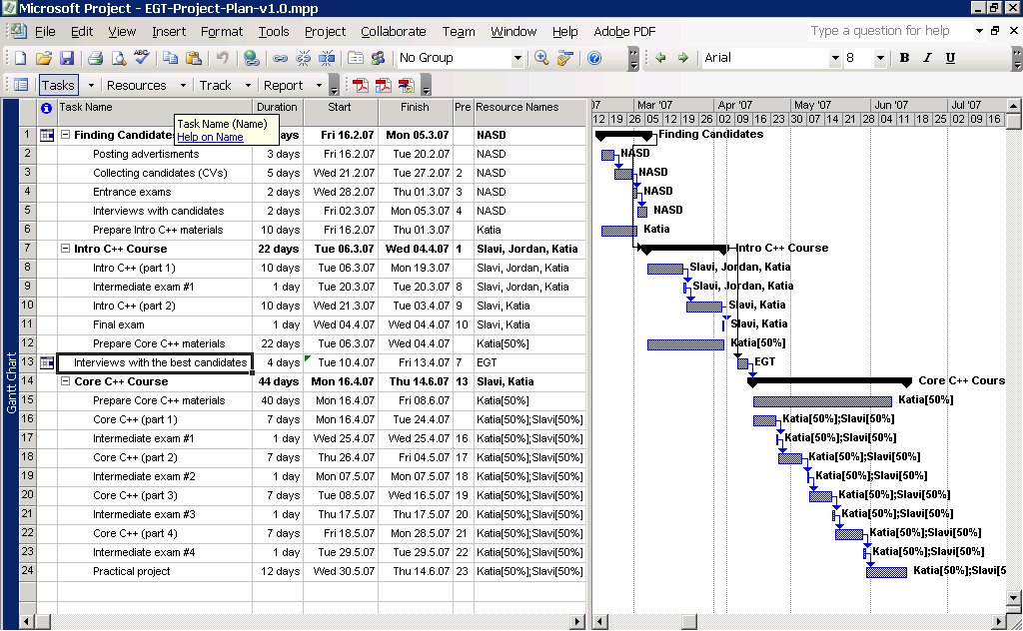
Project Plan – Example

Slide 42

Development Methodologies
Waterfall, Scrum, Lean Development, Kanban, Extreme Programming

Slide 43
What is a Development Methodology?
A development methodology is a set of practices and procedures for organizing the software development process
A set of rules that developers have to follow
A set of conventions the organization decides to follow
A systematical, engineering approach for organizing and managing software projects
Heavyweight and agile methodologies
Heavy methodologies rely on formal procedures and documents
Agile methodologies rely on small iterations and less formalities

Slide 44
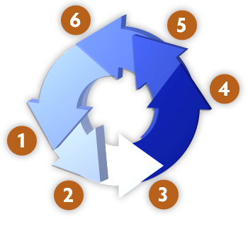
Development Methodologies
Back in history
The "Waterfall" Process
Old-fashioned, rarely used today
Rational Unified Process (RUP)
Microsoft Solutions Framework (MSF)
Modern development methodologies
Agile development processes
Scrum, Kanban, Lean Development, Extreme Programming (XP), …

Slide 45



The Waterfall Development Process

Slide 46
The Waterfall Development Process
Software
Requirements
Software
Design
Implementation
(Coding)
Verification
(Testing)
Operation
(Maintenance)
Notes:
It’s only in testing that your design is tested against reality. At this point you always learn something about your design (usually that it is wrong!), and that tells you something about your requirements (ditto!)

Slide 47
Formal Methodologies are Heavyweight!
Requirements
Full of documents,
diagrams, formal approvals, etc.
System
Requirements
Design
Analysis
Software
Requirements
Detailed Design
Coding
Software
Requirements
Specification
Preliminary
Design
Integration
Testing
Analysis
Preliminary
Design
Document
Prelim.
Review
Program
Design
Usage
Design Review
Coding
Operating
Instructions
Testing
UI Design Document
Final
Design
Code Review
Test
Plan
Operations

Slide 48

Agile Development

Slide 49

The Agile Manifesto
“Our highest priority is to satisfy the
customer through early and continuous
delivery of valuable software“
Manifesto for Agile
The Agile Spirit

Slide 50




The Agile Spirit
Incremental
Working software over heavy documentation
Cooperation
Customer collaboration over contract negotiation
Straightforward
Individuals and interactions over processes and tools
Adaptive
Responding to change over following a plan

Slide 51
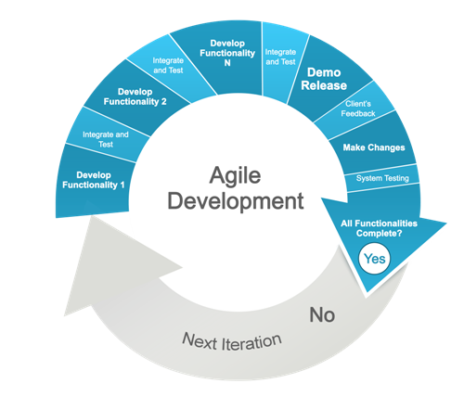
Agile Methodologies
Scrum
Kanban
Lean Software Development
eXtreme Programming (XP)
Feature-Driven Development (FDD)
Crystal Family of Methodologies
Adaptive Software Development (ASD)
Dynamic System Development Model (DSDM)
Agile Unified Process (AUP)

Slide 52

Scrum
Scrum is an iterative and incremental agile software development methodology for managing product development
Very popular in the software industry
Scrum roles:
Scrum Master – maintains the Scrum processes
Product Owner – represents the stakeholders
Team – a group of about 7 people
Does the actual development: analysis, design, implementation, testing, etc.

Slide 53
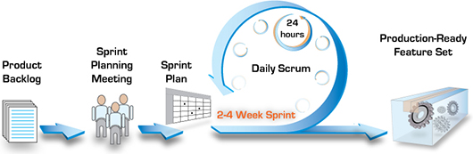
Scrum Terminology
Sprint
An iteration in Scrum
Usually a few weeks
Product Backlog
All features that have to be developed
Sprint Backlog
All features planned for the current sprint

Slide 54
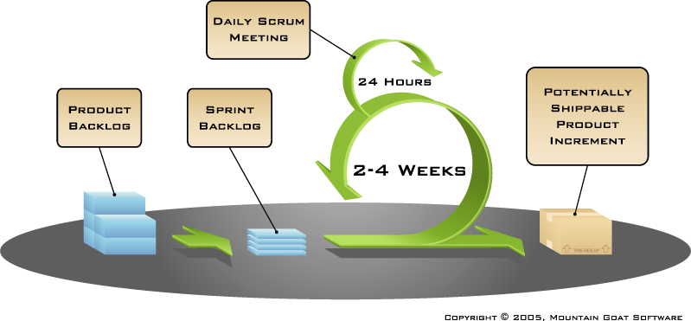
The Scrum Process Framework

Slide 55
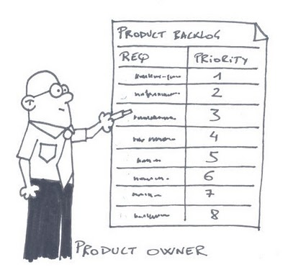
Scrum Practices
Sprint Planning Meeting
At the beginning of the sprint cycle
Establish the Sprint backlog
Daily Scrum stand-up meeting
Each day during the sprint
Project status from each team member
Timeboxed to 15 minutes
Sprint Review Meeting
Review the work completed / not completed

Slide 56

Summary
Behavioral Design Patterns:
Chain of Responsibility, Iterator, Command, Template Method, Strategy, Mediator, Memento, State, Interpreter, Visitor
Architectural Design Patterns:
MVC
MVP
MVVM

Slide 57









Software Engineering Fundamentals
http://softuni.org/courses/high-quality-code

Slide 58

License
This course (slides, examples, demos, videos, homework, etc.) is licensed under the "Creative Commons Attribution-NonCommercial-ShareAlike 4.0 International" license
Attribution: this work may contain portions from
"Fundamentals of Computer Programming with C#" book by Svetlin Nakov & Co. under CC-BY-SA license
"C# Part I" course by Telerik Academy under CC-BY-NC-SA license

Slide 59






Free Trainings @ Software University
Software University Foundation – softuni.org
Software University – High-Quality Education, Profession and Job for Software Developers
softuni.bg
Software University @ Facebook
facebook.com/SoftwareUniversity
Software University @ YouTube
youtube.com/SoftwareUniversity
Software University Forums – forum.softuni.bg

